Slide 1

IJAZ ALI
RTS LAB
2017/05/15

Slide 2
Introduction
In this paper, they present Morpheus, a system designed to resolve the tension between predictability and utilization that they discovered thorough analysis of cluster workloads and operator/user dynamics.Morpheus builds on three key ideas
automatically deriving service Level Objectives (SLOs ) and job resource models from historical data
relying on recurrent reservations and packing algorithms to enforce SLOs
dynamic reprovisioning to mitigate inherent execution variance.

Slide 3
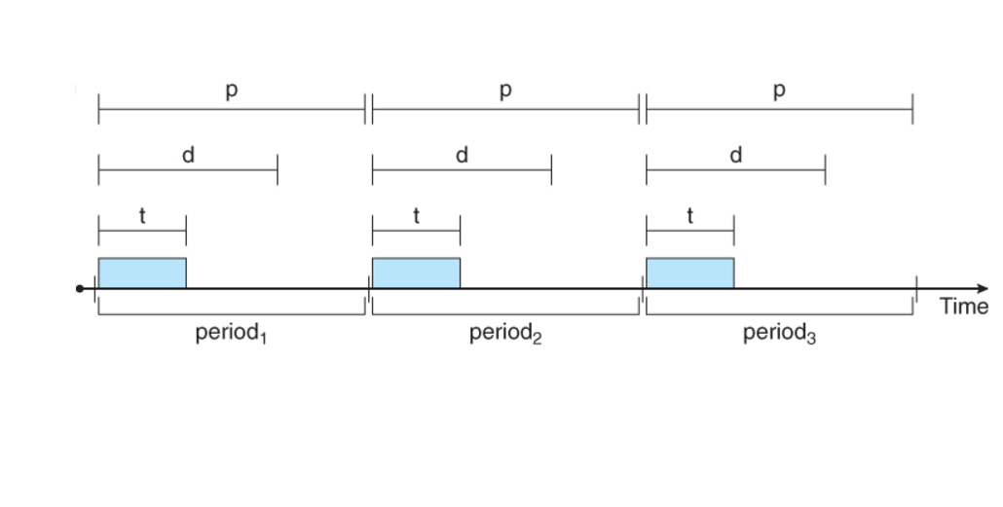
Periodic Task The interval between two consecutive activation is the periodic task
Aperiodic
The task that have irregular arrival time is a periodic task
Notes:
Periodic :recurring at intervals of time or occurring or appearing at regular intervals:

Slide 4
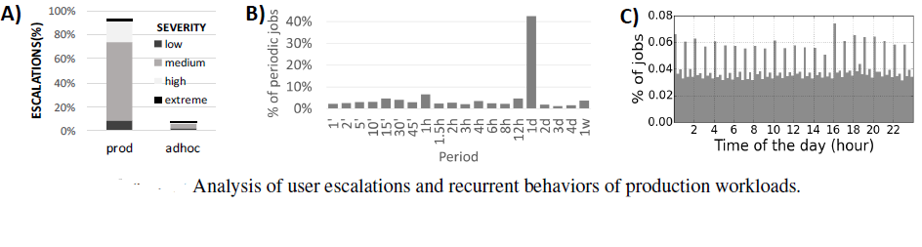
What do users of big data clusters care about?
Based on interviews with cluster operators and users, they isolate one observable metric which users care about job completion by a deadline Specifically, from analyzing the escalation tickets, some users seem to form expectations such as “95% of job X runs should complete by 5pm”. Other users are not able to specify a concrete deadline but do state that other teams rely on the output of their job and may need it in a timely manner.

Slide 5
Cont.…
Over 75% of the workload is production jobs Users are 120x more likely to complain about performance (un)predictability than about fairness
Over 60% of the jobs in the largest clusters are recurrent Most of these recurring jobs are production jobs operating on continuously arriving data, hence are periodic in nature The periods tend to be natural values (once a day, once an hour etc.)

Slide 6
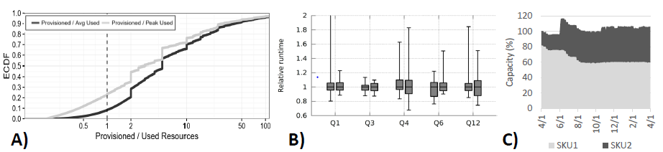
Predictability challenges
Manual tuning of jobs is hard 75% of jobs are over‑provisioned even at their peak. 20% of jobs are more than 10x over‑provisioned Users don’t change the provisioning settings for their periodic jobs beyond the initial set‑up (80% of periodic jobs saw no change in their resource provisioning)
This is notable because even seemingly minor hardware differences can impact job runtime significantly e.g., 40% difference in runtime on SKU1 vs SKU2 for a Spark production job.
Jobs don’t stand still – within a one‑month trace of data, 15‑20% of periodic jobs had at least one large code delta and over 50% had at least one small delta.
Even an optimal static tuning is likely going to drift out of optimality over time.
Notes:
perid

Slide 7
Morpheus overview
Given job that is periodically submitted by a user with manually provisioned resources Morpheus quietly monitors the job over time and captures
a provenance graph with data dependencies and ingress/egress operations
telemetry history in the form of resource skylines
Following a number of successful runs of the job, an SLO inference component performs an offline analysis. Using the provenance graph it determines a deadline for completion, the SLO (Service Level Objective), and using the skylines it determines a model of the job resource demand over time
At this point, the system is ready to take over resource provisioning for the job, but before it does so
Notes:
Periodic :recurring at intervals of time or occurring or appearing at regular intervals:

Slide 8
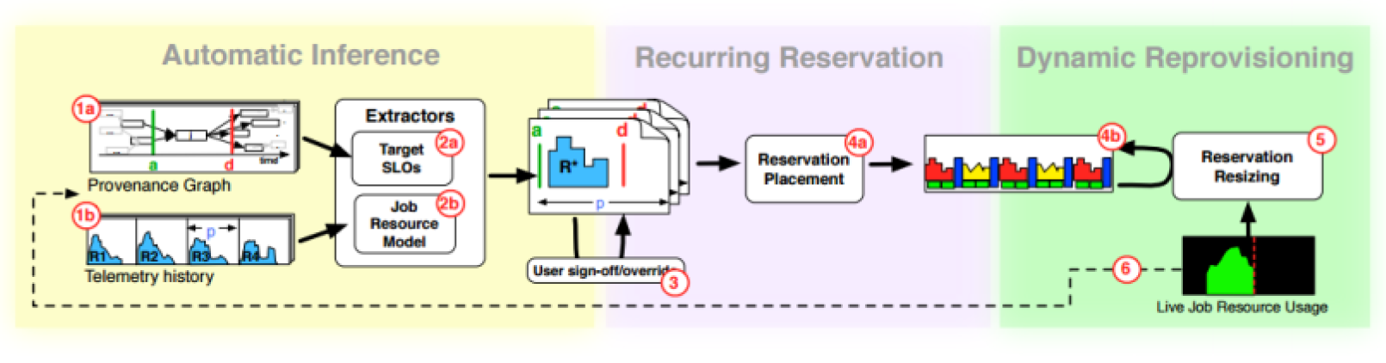
Cont.…
The user signs‑off (or optionally overrides) the automatically‑generated SLO and job resource model
Morpheus then uses recurring reservations for each managed job. These set aside resources over time for running the job, based on the job resource model, and each new instance of the job runs using these dedicated resources.

Slide 9
Cont.…
To address variability, a dynamic reprovisioning component monitors job progress online and adjusts the reservation in real‑time to mitigate the inherent execution variability.
Job runs continue to be monitored to learn and refine the SLO and job resource model over time

Slide 10
Agreeing on SLOs…
Petabytes of logs gathered daily across the production environments are processed to create a “semantically rich and compact (few TBs) graph representation of the raw logs.”
This representation gives us a unique vantage point with nearly perfect close‑world knowledge of the meaningful events in the cluster
They say that a job has an actionable deadline if its output is consumed at an approximately fixed time relative to the start of the period (e.g., everyday at 4pm), and if there is a non‑trivial amount of slack between the job end and the deadline.

Slide 11
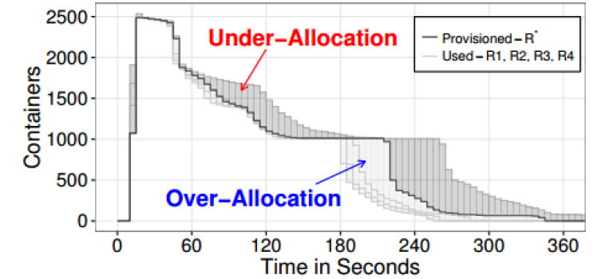
Job Resource Demand
LP deriving a provisioned skyline R, from four runs (R1-R4) of TPC-H Query12 (10TB scale).
In a nutshell Morpheus collects resources that have run in the past and solves an LP that “best fits” all patterns fig show 4 runs (R1-R4) of a TPC-H query that were used, along with other runs
The underlying optimization is governed by a parameter a 2 [0;1] which determines the extent to which one wishes to reduce over-allocation of resources
Over-allocation penalty: The over-allocation penalty is defined as the average over-allocation of containers.
Under-allocation penalty: They define a penalty which captures the eventual under-allocation of resources.

Slide 12
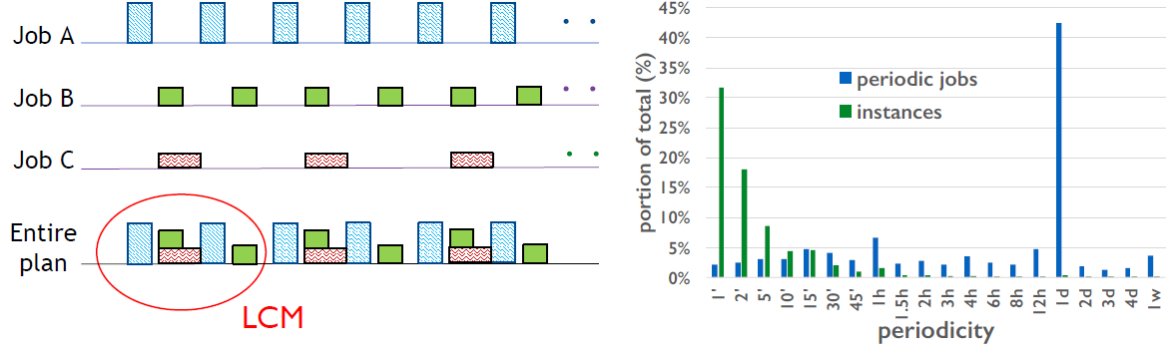
LCM Representation
They identify and store the smallest repeating unit which can accurately capture this recurring pattern in the set of all periodic jobs .They use the Least Common Multiple (LCM) of the time periods as the length of the internal storage unit.
This ensures that all periodic jobs align with the boundaries of the storage unit
one may argue that the LCM can get very large due to slightly “off-kilter periods of few jobs
the distribution of periods in our clusters shows that most period values are divisors of one day.

Slide 13
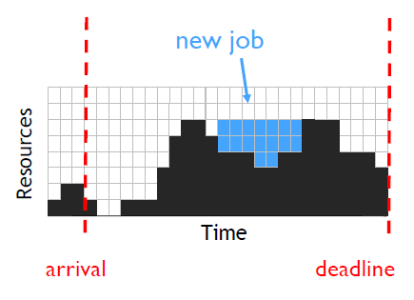
Other key techniques (in the paper)
Low-cost Packing Algorithm
Heuristic for achieving a balanced allocation
Load-aware online packing
Dynamic reprovisioning
Continuous monitoring of jobs
Allocate more resources when “progress” is slow

Slide 14
Experiments
Implementation:
Recurrent reservation mechanism, packing algorithm, and dynamic reprovisioning in Apache Hadoop/YARN Stand-alone inference subsystem
Workload:
Enterprise-trace: Three-month trace from 50k-node COSMOS cluster
Hadoop-trace: One-month trace from 4k-node Hadoop cluster
TPC-H: Standard TPC-H benchmark

Slide 15
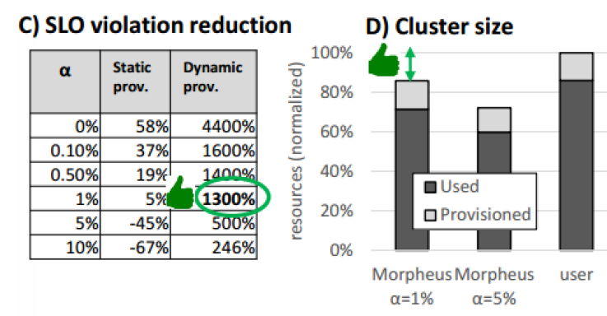
Results
In a simulation run from the largest dataset available to the team, Morpheus was able to automatically derive SLOs for over 70% of the millions of instances of periodic jobs in the trace.
Compared to the current manual provisioning, Morpheus reduces worst‑case SLO misses by 13x! The packing algorithm does a good job of driving utilization at the same time,lowering the overall cluster cost

Slide 16
Cont.…
SLO extraction and packing contribute to lower the baseline cluster size by 6%. Job resource modeling (using the extracted skyline rather than user supplied provisioning)
lowers cluster size by a further 16%. Combined they give a 19% reduction.

Slide 17
Conclusion
Predictable performance with lesser resources and higher utilization
Three main ideas
Automatic inference
Recurrent reservations
Dynamic reprovisioning
5-13x reduction in SLO violations
14-28% reduction in cluster size

Slide 18
THANK YOU!

